Slide 1
Making of District Disaster Management Plans A process outline

Slide 2
Agenda
Background
Rationale for Disaster Management Planning
Model DDMP development
Scale up of Madhubani model
Contents of DDMPs
DDMP development process – case of Bihar
Technology applications in disaster management and planning

Slide 3
Agenda
Background
Rationale for Disaster Management Planning
Model DDMP development
Scale up of Madhubani model
Contents of DDMPs
DDMP development process – case of Bihar
Technology applications in disaster management and planning

Slide 4
Disaster
As per DM Act-2005
“Disaster” means a catastrophe, mishap, calamity or grave occurance in any area, arising from natural or man made causes, or by accident or negligence which results in substantial loss of life or human suffering or damage to, and destruction of, property, or damage to, or degradation of, environment, and is of such a nature or magnitude as to be beyond the coping capacity of the community of the affected area. ¹
²
Source: ¹ DM Act 2005; ² DM Act 2005

Slide 5
The institutional framework for preparation of DDMPs has been set up under the DM Act 2005
National Disaster Management Act (2005) – Genesis ¹
Timeline and Roadmap
November 2005 – DM act was passed by Lower house (Lok sabha)
December 2005 – DM act was passed by Upper houses (Rajya sabha)
January 2006 – DM act received assent from the president
Structure of the DM acts
11 chapters and 79 sections
Establishment of National Disaster Management Authority (NDMA)
Prime Minister of India as chairperson
Provision for state governments
Under section 14 of the DM act, All State Governments are mandated under Section to establish a State Disaster Management Authority (SDMA) and DDMAs
Source: DM Act 2005; Handbook of Disaster Management in India

Slide 6
District Disaster Management Authority (DDMA)
Chapter IV of the DM Act-2005
Section 26
Chairperson of the DDMA to preside over the meetings of the DDMA
Exercise and discharge such powers and functions of the DDMA
Section 27
Meetings
Section 28
Advisory committee
Section 29
SDMA support to DDMA in form of officers, consultants, employees
Section 30
Act as district planning, coordinating and implementing body for disaster management
Prepare DM plan
Section 31
There shall be a plan for disaster management for every district of the State.
The District Plan shall be prepared by the District Authority, after consultation with the local authorities and having regard to the National Plan and the State Plan, to be approved by the State Authority.
Source: DM Act 2005;

Slide 7
Role of departments
Chapter IV of the DM Act-2005
Section 32
Under the supervision of District Authority,
Prepare a DM plan
Provision for prevention and mitigation
Provision for capacity building and preparedness
Response plans and procedures, in the event of, any threatening disaster situation or disaster
Coordinate the preparation and implementation of plan
Regularly review and update the plan
Submit a copy of its DM plan to the District Authority
Section 33
District Authority may order any dept./officer to take measures of prevention or mitigation, or response to disaster, and such dept./officer shall be bound to carry out such order.
Source: DM Act 2005;

Slide 8
NGOs and Private sector
Chapter IV of the DM Act-2005
Clause 24 (g, h and j)
empowers SEC and DDMAs to seek services / expertise from NGOs and private sectors to be used during disasters or threatening disaster situations:
Clause 34 (i)
District authority may
require experts and consultants in the relevant fields to advise and assist as it may deem necessary
Source: DM Act 2005;

Slide 9
National Disaster Management Plan, 2016
Section 1.11
Local authorities (PRIs, Municipal Corporations, Municipalities, District and Cantonment Boards and Town Planning Authorities) will prepare DM Plans in consonance with the Guidelines of NDMA, SDMAs and DDMAs and will ensure capacity building of their officers and employees for managing disasters, carry out relief, rehabilitation and reconstruction activities in the affected areas.
Source: DM Act 2005

Slide 10
Offences and Penalties
Chapter X of the DM Act-2005
Section 51
Imprisonment of upto 1 year, or fine, or both.
Imprisonment of upto 2 years (in case of loss of life, or imminent danger thereof)
Section 52-60
Other important clauses
Source: DM Act 2005

Slide 11
Agenda
Background
Rationale for Disaster Management Planning
Model DDMP development
Scale up of Madhubani model
Contents of DDMPs
DDMP development process – case of Bihar
Technology applications in disaster management and planning

Slide 12
Rationale for development of DDMPs
due to non-availability of any model framework, lack of resources and subject matter expertise
Disaster Management Act 2005
Chapter IV, Clause 31(1)
Gaps in existing DDMP (or non availability of DDMP)
Usefulness/practicability of DDMPs
Lack of SOPs, ready reckoners
Poor participation (and ownership) of stakeholders
Lack of coordinated approach
Most plans were like directory/inventory
Plans were rarely used in recent disasters
Focus on one hazard (flood)
Lack of DRR approach
Did not address emerging concerns of climate change, rapid urbanization, crowd management, school safety, hospital safety, industrial preparedness, livestock plan
Source: Review of existing DDMPs of many districts in Bihar, Assam, Rajasthan, Uttarakhand, Gujarat etc.

Slide 13
Agenda
Background
Rationale for Disaster Management Planning
Model DDMP development
Scale up of Madhubani model
Contents of DDMPs
DDMP development process – case of Bihar
Technology applications in disaster management and planning

Slide 14
Conceptualization of model DDMP development
Review of DDMPs developed by different agencies including NIDM, UNDP etc.
Analysis of critical gaps
Development of framework for DDMP (template vs. framework)
NDMA initiated the process for development of first DDMP pilot at Madhubani, Bihar
Formation of Advisory bodies
National level (led by NDMA-Shri. T. Nand Kumar, Member) + NIDM, IIPA, Tear Fund, UNDP, IFRC, CRS, DCA, EFICOR, Cordaid, Sphere India
State level (led by BSDMA-Shri. Anil Sinha, VC) + Dept. of DM, State IAG
District level (led by DDMA-Shri. Sanjeev Hans, Chairman) + District IAG
Source: Guidance from advisory groups at Natinal, State and District level during development of Model DDMP of Madhubani

Slide 15
Six step approach to DDMP development in India
6. Institutionalization
2. Framework development
1. Conceptualization
3. Model plan
4. Replication
5. Scale up

Slide 16
Principles observed in DDMP development
Inclusive
Contextual (with respect to local system, governance, culture, capacity)
Bottom-up approach
Participatory (Active participation of all stakeholders at various levels)
Collaborative (GO-NGO collaboration, joint planning and action)
Targeted (Focus on vulnerable geographies and groups)
Sustainability (Alignment and mainstreaming with development programs)
Source: Guidance from advisory groups

Slide 17
Strategic policy framework for DDMP development
Ensuring a comprehensive, all hazards, all agencies approach by achieving the right balance of prevention, preparedness, response and recovery;
Supporting the mainstreaming of disaster preparedness and mitigation into relevant areas of activity of government, non-government, small business and corporations;
Aligning disaster risk reduction, disaster mitigation, disaster resilience and climate change adaptation policy and actions with international and national reforms;
Promoting a transparent, systematic and consistent approach to disaster risk assessment and management, based on the National Disaster Management Policy/ Act.
Recognizing the commitment of stakeholders and the need for collaboration across all levels of government, community, industry, commerce, government owned corporations, private and volunteer organizations, and local communities in all aspects of disaster management;
Emphasizing building and maintaining sincere relationships, trust, teamwork, consultative decision-making and shared responsibilities among stakeholders; and
Promoting community resilience and economic sustainability through disaster risk reduction.
Source: National framework for development of DDMPs

Slide 18
Model DDMP development
Selection of Madhubani as first pilot (through consultative process due to its multi hazard vulnerability)
Macro Analysis: Classification of GP’s in four types, Embankment vulnerability review, River Management at Barrages, Earthquake Safety, Drought risk mitigation
Micro Analysis:
HRVCA of four types of GPs (14) and Blocks (4): 3 panchayats and 1 block was selected for each type of flood vulnerability scenario, 1 GP led by woman Sarpanch and 1 Panchayat led by Dalit Sarpanch were selected in addition to 12 Panchyats for inclusive consultative process.
Consultation with stakeholder groups (communities, line departments and other stakeholders for their action plans (40 groups)
Drafting of DDMP, consultation with district stakeholders, improvements, and sharing to State & National advisory groups
Addition of Crowd Management Plan (after review meeting in BSDMA on 13th Feb, 2013)
Presentation of final documents in DDMA Madhubani
Translation (in Hindi) and designing of documents for launch.
Initial draft of 4 volumes synthesized to final 2 volumes (Vol-1: DRR Plan, Vol-2: Response Plan)
Source: Madhubani DDMP development process report

Slide 19
Key features of Madhubani model DDMP
Comprehensive, Multi-hazards planning
Plan for prevention, preparedness, response and recovery as well as capacity building, implementation, monitoring and review/updation
Actions for mainstreaming DRR in regular programs/schemes/departmental plans and plans of NGOs, small business and corporations
Multi-disciplinary, multi-stakeholder and participatory approach
Intra-Government (key departments) participation
Plan for Capacity development across levels, across stakeholder domains
Planning for Essential Service Functions (and their continuity)
Consideration for Worst case scenario
Follow-up actions after development of the DDMP
Source: Madhubani model DDMP

Slide 20
Timeline of Madhubani DDMP development
Consultations at National, State & District
Draft plan review at State & district level
HVCA
Draft plan writing
Review and editing at National level
Design of outputs
Presentation in DDMA
Jan-Feb, 11
March, 11
Jul-Nov, 11
Nov, 11
Jan, 12
Jan, 12
Feb, 12
Apr, 12
May, 12
June-Dec, 12
Dec, 12
Feb, 13
Apr, 13
Jul, 13
Draft template
Community consultation on EW
Draft plan review at National level
Consultation on draft plan at district
Review and editing at state level, & other key stakeholders
Review meeting at BSDMA
Lanch of DDMP
Edu., Agri., PHED, PRI, IAG
Source: Madhubani model DDMP

Slide 21
Way ahead from Madhubani model plan
Madhubani model DDMP endorsed by NDMA, BSDMA and DDMA
Madhubani model plan was adopted and launched by Govt. of Bihar (BSDMA)
Uploaded at BSDMA website as model DDMP
http://bsdma.org/DMP.aspx?id=2
Process document developed for helping replication and scale-up (for preparation of DDMPs)
Source: Madhubani model DDMP

Slide 22
Agenda
Background
Rationale for Disaster Management Planning
Model DDMP development
Scale up of Madhubani model
Contents of DDMPs
DDMP development process – case of Bihar
Technology applications in disaster management and planning

Slide 23
Replication of Madhubani DDMP model in Bihar and other states
Madhubani model replicated in Rajasthan (Jodhpur), Uttarakhand (Uttarkashi), Assam (Majuli), and 4 districts of Bihar (2013-14)
Govt. of Bihar decision to scale up to cover the entire state (2015)
Scale up of Madhubani model in different states including all 38 districts of Bihar (ongoing)

Slide 24
Highlights of scale-up with respect to Madhubani model DDMP
Scale-up is not just copying the Madhubani model, but it is Contextualization, adaptation and incorporating new instruments…
Issues/ Gaps in previous DDMPs | Madhubani Model DDMP | Scale up DDMPs
Focus on one hazard (flood) | Multi-hazard | Multi-hazard
Lack of DRR approach | DRR included | DRR included
Lack of SOPs/ready reckoners | Included | Included
Poor participation and ownership | Highly participatory process, high ownership | Highly participatory process, high ownership
Directory/inventory type DDMP | Improved | Improved
Crowd management | Included | Included
Concerns of climate change | Not addressed | Addressed
Concerns of rapid urbanization | Not addressed | Addressed
School safety | Not addressed | Addressed
Hospital safety | Not addressed | Addressed
Industrial safety/preparedness | Not addressed | Addressed
Livestock planning | Not addressed | Addressed
MISP | Not addressed | Addressed
HRVCA | 14 GPs, 4 blocks | 5% GPs (at-least 1 GP from each block)

Slide 25
Agenda
Background
Rationale for Disaster Management Planning
Model DDMP development
Scale up of Madhubani model
Contents of DDMPs
DDMP development process – case of Bihar
Technology applications in disaster management and planning

Slide 26
Contents of DDMP: Volume-1: DRR Plan (Green Book)
Sl. No | Item | Details
1 | Contextual analysis | Analysis of existing scenario Political/ administrative, Technology, Economic, Social, Climatic Regulatory framework (DM Act, relevant sections, organizational -etc) DM efforts at districts
2 | Problem identification and analysis | HRVCA Micro and Macro analysis
3 | Stakeholder analysis | Identify stakeholders across the three levels (Gram panchayat level, District level (Line Department), Other stakeholder)
4 | Development strategy | Comprehensive Planning Essential Service Functions (ESF), Incident Response System (IRS) Integration and Coordination of all stakeholders and essential services Functions Worst case scenario and contingency planning Follow ups

Slide 27
Contents of DDMP: Volume-1: DRR Plan (Green Book)
Sl. No | Item | Details
5 | DRR plan | Legal framework Awareness strategy Institutional mechanism Implementation plan (including plan to keep machinery in good shape for use during disasters) Financial management Frontline staff training and other training inventory School safety/ hospital safety plan/ industrial safety plan CCA plan Livelihood restoration plan Stakeholder Plan (line departments, GP committees, other stakehodlrs such as NGOs, business groups, academia, media, transporters, NSS, NCC, Youth groups etc

Slide 28
Contents of DDMP: Volume-2: Response Plan (Red Book)
Sl. No | Item | Details
1 | Actions common to all Disasters | Actions on receipt of early warning Actions for response activation Action for relief and response Search and rescue Initial assessment Relief distribution Monitoring Deactivation of response Recovery actions Action plan for different stakeholders
2 | Specific contingency situation actions | 2.1. Contingency action for Floods 2.2. Contingency action for Earthquakes 2.3. Contingency action for Droughts 2.4. Contingency action for Fire 2.5 Crowd management
3 | Setting up Field Emergency Operation Center (EOC) or coordination mechanism | 3.1 Setting up of EOCs & EOC coordination system 3.2 Role of EOC during disaster 3.3 Role of EOC in normal time 3.4. Onsite EOCs
4 | Database | Important contacts, resource, vulnerabilities, maps, etc.

Slide 29
Agenda
Background
Rationale for Disaster Management Planning
Model DDMP development
Scale up of Madhubani model
Contents of DDMPs
DDMP development process – case of Bihar
Technology applications in disaster management and planning

Slide 30
Approach and stages
Existing System Study
Gap / requirement assessment
Design of DDMP
Macro analysis (desk level)
Review of national level DM act, Policy
Review of existing SDMP and DDMP
Study of vulnerability atlas
Study of existing
Organization structure
Institutional structure
Awareness level *
Legal regime
stakeholder analysis
Micro analysis (field level) *
Hazard profile assessment (HVCA)
Capacity analysis
Study of good practices and Lessons learnt from past disasters
National case analysis
International case analysis
Gap Analysis
Assessment of improvement areas
Categorization of improvement areas
DRR plan (Green Book)
Disaster mitigation plan
Legal framework
Implementation plan
Institutional structure
Awareness plan
Capacity building plan
Budgetary estimates
Action plan
Stakeholder improvement plan
Disaster Response and Recovery plan (Red Book)
Action plan
Contingency situation plan
EOC
Roles fixation/ definition
Key Components
Include plans for school safety, hospital safety, industrial safety, livestock, crowd management,

Slide 31
Process management by BSDMA
Preparation of SOW and TOR (through consultative process)
Open bidding and hiring of agencies
Inception workshop
Resource person from BSDMA assigned for each district plan
Periodical review and reflection workshops
Common WhatsApp group (including DMs, Nodal Officers, NDMA, BSDMA, DMD, NIDM, BIPARD, IAG, implementing agencies) for open sharing of experiences
Openness to trouble shooting and facilitation
Hired agencies are being treated as partners in the making of DDMP (not contractors)
Active involvement of BSDMA-VC and members in nurturing the process
Approach to harmonization (in process and contents of DDMPs)

Slide 32
Steps in DDMP development
8
1
Design Process for Operationalization and Review of DDMP
Review and
Integration
of existing DDMPs
7
2
Designing Process/Protocol for stakeholder engagement
Setting up of multi-stakeholder consulting group
Methodology
Review of good practices and lessons learnt from past disasters
Multi-stakeholder
consultation
6
Data collection
Hazard Vulnerability & Capability Analysis (HVCA)
3
5
4

Slide 33
Methodology description
Step | Action | Description
1 | Review and Integration of existing DDMPs | Desk review of existing documentation Comprehensive assessment of DM initiatives of the present and that of near future
2 | Setting up of multi-stakeholder advisory group * | The stakeholders will include PRIs, key nodal departments, DRDA, District Magistrate/Commissioner, representative from Dept. of Disaster Management and SDMA This group will be consulted time and again throughout the process of development of DDMPs
3 | Multi-stakeholder consultation * | To seek feedbacks and inputs on the existing plan and to understand their views District level workshops will be conducted to expedite consultations. The key stakeholders will include Community representatives; PRIs (Gram Pradhans / Up-Pradhans); Jila Panchayat Key NGOs, DDMA, DRDA etc The draft DDMP shall be consulted with the stakeholders for their inputs and feedbacks. The draft shall be further modified and finalized

Slide 34
Methodology (cont.)
Step | Action | Description
4 | Hazard Vulnerability & Capability Analysis (HVCA) | Detailed assessment of hazard and vulnerability profile GIS mapping
5 | Data collection | Questionnaire for data collection and circulate with SDMA/DDMA for onward circulation to various government departments
6 | Review of good practices and lessons learnt * | Study and incorporation of learning from best practices in disaster management across every disaster prevalent in the state One example from national and international best practices will be provided

Slide 35
Methodology (cont.)
Step | Action | Description
7 | Designing Process/Protocol for stakeholder engagement | To state the process as to how various stakeholders (government, non government, private, business, community) will be involved the planning and implementation
8 | Design Process for Operationalization and Review of DDMP | To state comprehensively the process that will guide the DDMA in Promoting community awareness Enhancing their resilience Ensure system readiness and preparedness to respond Capacity development of the stakeholders, Methods to practice the process through simulation and mock drills, Processes to review and revise the plan periodically.

Slide 36
Approach and Methodology
Improvements in view of recent developments – such as
Capacity building plan,
Mitigation activities,
Financial management plan,
Action oriented plan at district, block and panchayat level,
Monitoring plan,
DIA/DRA,
Planning for school safety, hospital safety, industry safety
Mainstreaming of DRR and CCA
Post disaster livelihood restoration
Livestock safety
Safety of historical / heritage sites

Slide 37
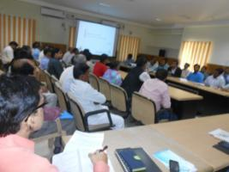
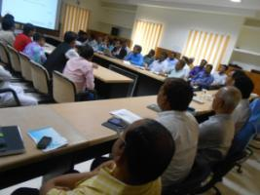
Example of process followed in Nawada district
District level stakeholders consultation in Nawada (31st October, 2015)
Chaired by DM Shri. Manoj Kumar
Attended by over 60 participants from different departments and stakeholders (department representatives, BDOs, COs, NGO representatives etc.)
Key issues highlighted by participants:
Flood like condition develops in Kokla sometimes in monsoon season due to heavy rains
Flash floods due to excessive rains in short period
Water logging - and sometimes people die due to ignorance and over confidence
Lightening – cases of deaths recorded
Accidents are common
Attack of wild animals (crops and human as well)
Rajauli block – children are disabled due to water related disases
High tension wire
Crowd management during festivals and Mela etc.

Slide 38
Inputs from stakeholders’ consultations
Meetings with officials in highlighted the need for concerted efforts to prevent man-made disasters as well which often happen due to negligence (viz. road safety awareness, fire safety, disease control with appropriate hygiene practices etc.)
Nawada district:
Health dept. → advice for formation of task force/group on medical/health response in emergencies.
Revenue dept. → requested for hazard specific maps representing vulnerable areas and population
Samastipur:
DPRO → focus on village level awareness campaigns for communities on different disasters, and their prevention, preparedness, risk reduction, mitigation and management etc.
Police dept. → some technological tool to help trace the location of the areas affected by disaster or some incidence.
NGO (Bal Kalyan) → advised on road safety (technological solutions should be explored to prevent accidents due to foggy weather and sharp bends & blind curves etc.)
Madhubani:
Displacement of people due to landslides and erosion etc.
Darbhanga:
ADM disaster and SDC → Exhaustive flood management plan is available as the district faces regular floods, but no other disasters

Slide 39
HRVCA process
HRVCA process 5% GPs or 1 GP in each block (minimum)
GIS mapping
Helped in developing understanding of key hazards, vulnerabilities, challenges, (non) availability of resources, local practices to cope with disasters etc.
The villages were identified in consultation with the nodal officer at the district, officials of DDMA/disaster management department, Apda in-charge etc., as well as local agencies working on disaster management were consulted.
Process followed: PRA exercises, participatory approach.
Village HRVCA map with identification of hazard/risk areas, vulnerabilities, and capacities/resources were prepared.
Seasonality analysis

Slide 40
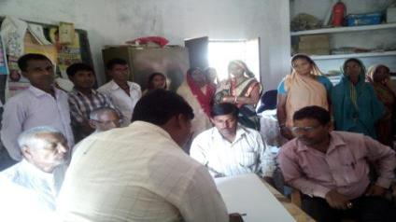
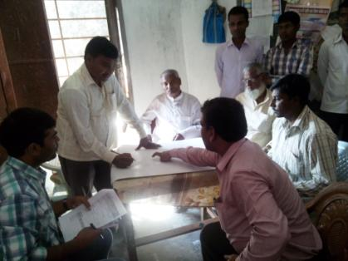
SAMASTIPUR DISTRICT Block: Singhia, G.P. – Kundal-2, Village – Nimi
GPS location of village Nimi
Lat. = 25.786854
Long. = 86.206667
Key findings
Flood prone (next to Kareh river)
Major floods in 1987, 2004, 2008
Water logging next to embankment
Hailstorm in 2015
Seismic zone IV (EQ in 1988)
Agriculture land inundated during monsoon (June-Aug/Sept)
Migration and daily wage labour (60% HH)
Kaccha houses – 516 HH
95% houses use firewood for fuel
Source: FGDs and Community interactions

Slide 41
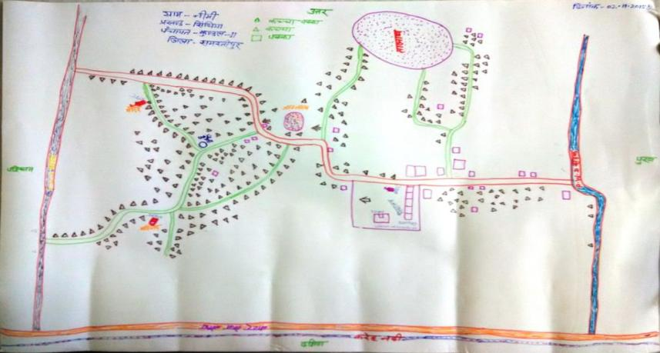
HRVCA map of village – Nimi

Slide 42
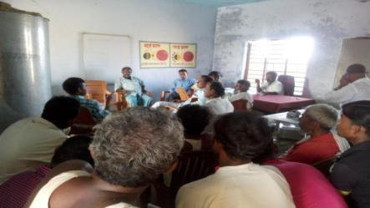
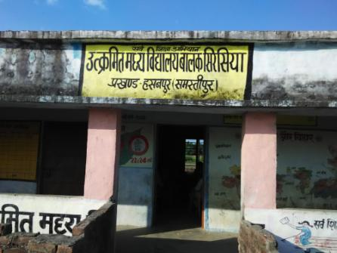
SAMASTIPUR DISTRICT Block: Hasanpur, G.P. – Bhatwan, Village – Sirsia
Key hazards and vulnerabilities
Flood prone (inside the embankment) – rivers Kosi and Kareh/Bagmati
Floods in every monsoon (embankment not completed (Western embankment of river Kosi to meet the Waterways embankment)
Most population lives b/w river and embankment (all SC, and labours), and few on the embankment (EBC) in thatched houses
Agriculture land inundated during monsoon (June-Aug/Sept)
Migration and daily wage labour (50% HH)
Kaccha houses – 790 HH (100% HH use firewood for cooking)
Fire in June 2015, more than 40 houses affected
GPS location of village Sirsia
Lat. = 25.772057
Long. = 86.234902
Source: FGDs and Community interactions

Slide 43
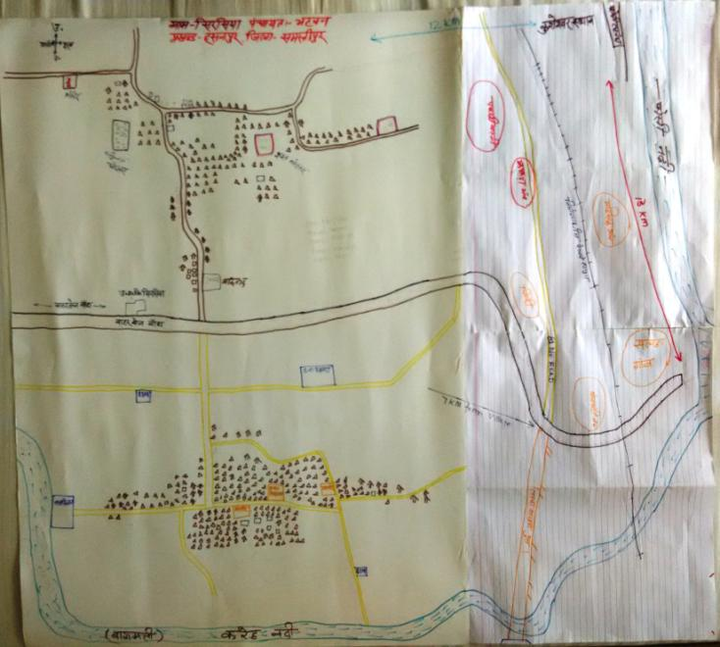
HRVCA map of village – Sirsia

Slide 44
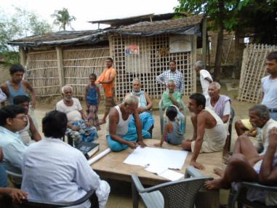
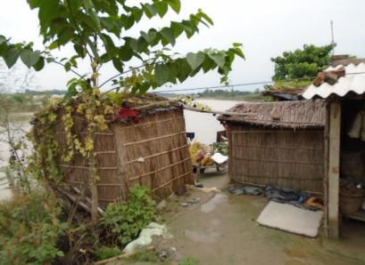
SAMASTIPUR DISTRICT Block: Kalyanpur, G.P. – Kalaunjar, Village – Gangaura
HRVCA and PRA is carried on at Gangoura Village |  | Enbankment erosion and River changing its way at Gangoura Village
Key hazards and vulnerabilities
Erosion of the embankment and the village land
Bagmati river changing its course year by year
Fire hazards (90% houses are thatched houses)
Accessibility disturbed during monsoon
Diseases – Malaria, Typhoid, Diarhea etc. (WASH issues)
Source: FGDs and Community interactions

Slide 45
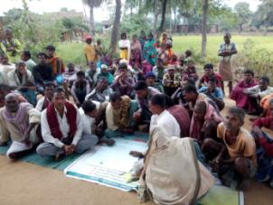
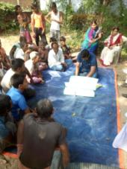
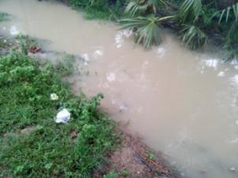
Nawada district
Block: Kashichak, G.P. – Khakhari,
Village – Nayadeeh
Fire incident (April, 2013)
Flood & waterlogging (threat from the Aahar of Dedhgaon village)
Diseases: Diarrhea, malaria, typhoid
Block: Kauwakol, G.P. – Lalpur,
Village – Badarwatari
Accessibility blocked during monsoon season (river Nati)
Attack of wild animals
Diseases: Malaria, typhoid, cholera, diarrhea
Block: Roh, G.P. – Chhanaun,
Village – Painpura
Flood due to canal and aahar
Accessibility
Diseases: Malaria, typhoid, cholera, diarrhea
Fire incident
Source: FGDs and Community interactions

Slide 46
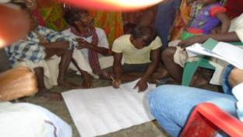
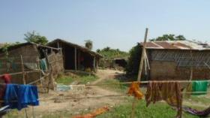
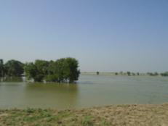
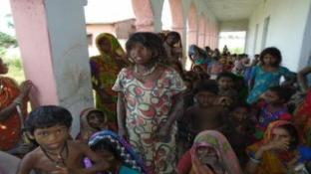
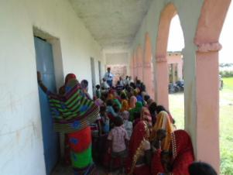
DARBHANGA DISTRICT Block: Tardih, G.P. – Thengha, Village – Thengha
Low land and flooded / water logged area
Community engaged in developing maps
Poor & weak hutments in the village
Women took active participation in the discussion
Issues of women, girls and children were consulted.
Source: FGDs and Community interactions

Slide 47
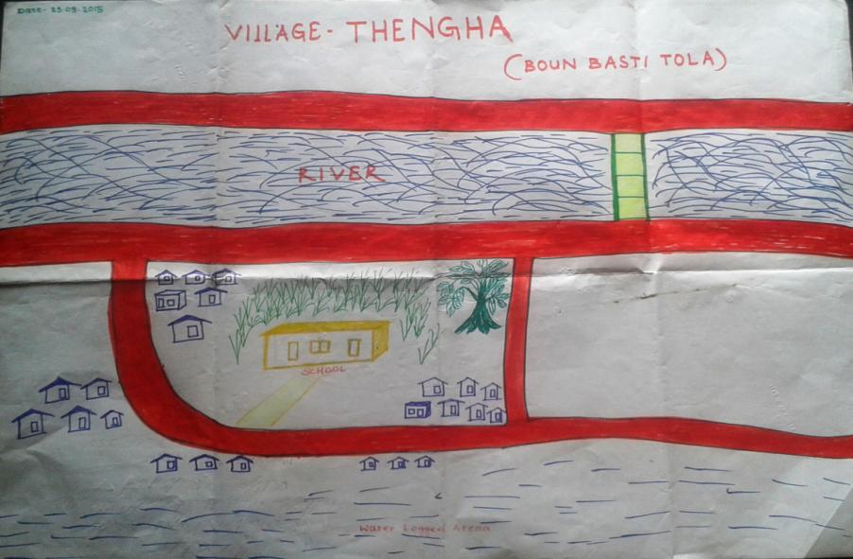
DARBHANGA DISTRICT Block: Tardih, G.P. – Thengha, Village – Thengha
Source: FGDs and Community interactions

Slide 48
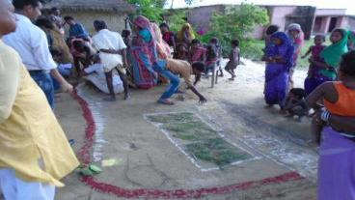
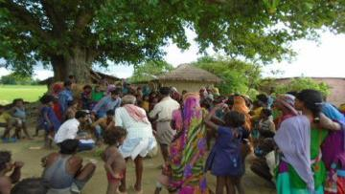
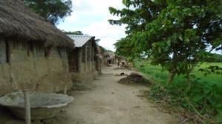
MADHUBANI DISTRICT Block: Madhepur, G.P. – Tardiha, Village – Aathvigha Mushahari (Tola)
Community engaged in developing village map on the ground
Active engagement of community members, specially women, children, youth and elderly
Series of thatched/katccha houses, increasing vulnerability towards floods, fire, storm etc.
Source: FGDs and Community interactions

Slide 49
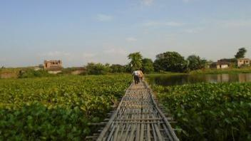
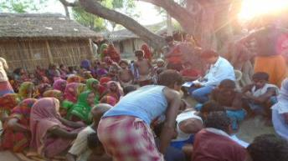
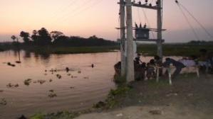
MADHUBANI DISTRICT Block: Madhepur, G.P. – Mahasingh Hasouli, Village – Behera
Chachree (wooden bridge) to go Maha Dalit Tola
Active participation of community members
Water logged area in the village
Source: FGDs and Community interactions

Slide 50
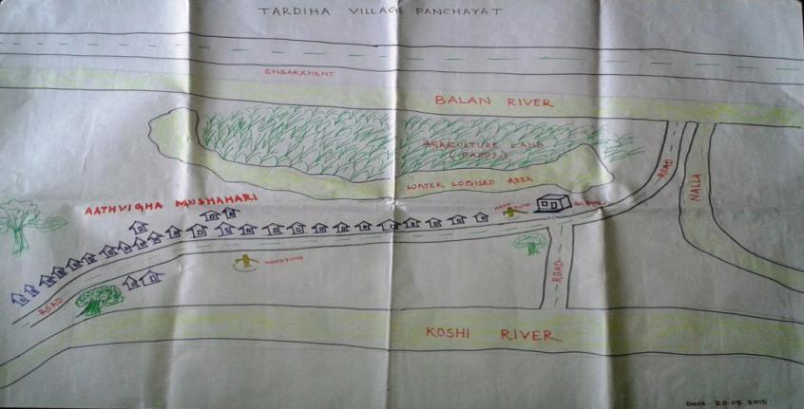
MADHUBANI DISTRICT Block: Madhepur, G.P. – Tardiha, Village – Aathvigha Mushahari (Tola)
Source: FGDs and Community interactions

Slide 51
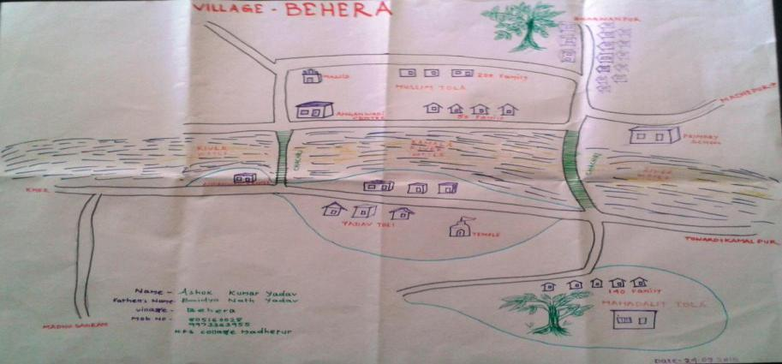
MADHUBANI DISTRICT Block: Madhepur, G.P. – Mahasingh Hasouli, Village – Behera
Source: FGDs and Community interactions

Slide 52
Key learning
Prevention measures highly useful in few hazards such as fire, disease outbreak. Awareness and IEC can play a significant role in prevention of such hazards.
Risk reduction starts after appreciation of risk which is very important for the intervention districts. For example: very few people in Nawada district share and appreciate about any hazard or risk present in the district, whereas Madhubani, Darbhanga, Samastipur have more focus on flood and to some extent on drought.
Post disaster action:
Officials consulted for their prior experiences in disaster response and management to understand successful measures and areas of improvements or challenges.
Learning and case stories from different places, both within Bihar, within India and also from neighboring countries are studied to understand what measures are successful and what could be improved and adapted.

Slide 53
Environment and CCA
Extreme events i.e. heat waves, cold waves, more intense floods, more droughts, more intense cyclones and flash floods are on increase. Agriculture, food security, water security and environmental degradation are key challenges
Efforts being considered in DDMP development in terms of environment and CCA:
More efficient weather forecasting, and its timely reach to communities
Crop diversification, improved crop cycle, more efficient water use, and improved soil management practices, together with the development of flood & drought-resistant crops can help reduce some of the negative impacts.
Promotion of alternative livelihood opportunities, skill development, entrepreneurship development
Taking initiatives to reduce dependency on environment, water etc. for livelihood
Generating local livelihood opportunities to curb migration
Suitable building codes and adherence to same
Incentivize efficient use of ground water resources
Improvements in irrigation systems, water harvesting techniques, and more-efficient agricultural water management
Regional cooperation on water issues

Slide 54
Challenges faced by agencies engaged in making of DDMPs
2 elections (General elections and Panchayat elections)
Loss of 5 months time
Staff retainer cost
Delay in activities
Delay in harmonization and standardization of process
Taxation – TDS as well as Service tax
Translation (costing and resources)
Field logistics cost (resources with DDMA to support field process cost)

Slide 55
Agenda
Background
Rationale for Disaster Management Planning
Model DDMP development
Scale up of Madhubani model
Contents of DDMPs
DDMP development process – case of Bihar
Technology applications in disaster management and planning

Slide 56
GIS is one of the widely used technologies for disaster mitigation plans
Web based GIS platform
Remote sensing
Advanced modeling techniques
Case study of GIS Bihar
Framework Spatial Data Service Oriented Architecture
On-line help & support services
Role based User Management
State of the art solution using latest GIS technology developed in web enabled environment
Thematic Maps Generated at various levels
Vulnerability analysis
Risk assessment
Real time data gathering
Data analysis
Preparation of digital maps
Hazard identification
Real time monitoring
Predictions and forecasting,
Early warning
Accurate forecasting
Early warning
Case in DDMP: UNICEF developed a GIS based District Disaster Management Plan for Samastipur, Bihar
Key challenges: Technical know-how, cost and change management as these skills are specialized and require specialized agencies for planning & implementation
Handholding is critical

Slide 57
New age technology trends useful for Disaster Mitigation
Technologies | Possible use cases
Cloud based disaster management applications | Real time data management – data input and analysis (on hazards, vulnerabilities, resources, directories) Real time plan monitoring and updation Quick decision making at all levels Dashboard / MIS for senior officials at district and state level Cloud technology helps keep data secure in a remote location during disaster occurrence and keeps the application alive
Social media such as facebook, whatsapp, messengers | Disaster management related information dissemination and information gathering, community based DRM (successfully used during Chennai floods)
Mobile applications | ICT, data gathering, resource mobilization and monitoring
eTools (learning and training) | Capacity building, disaster awareness
Internet based HAM radio | Emergency communications during diasters

Slide 58
Crowd Sourcing as technique for low cost data gathering
Possible uses of crowd sourcing
Data Gathering
Historical data gathering
Building and exposure data gathering
Event/Risk information Gathering
Benefits of crowd sourcing
Cost effective
Faster data gathering
Public engagement
Challenges of crowd sourcing
Data filtration
Authenticity of data source
Technology that can be used:
Web
Mobile Application
WhatsApp

Slide 59
Open session for discussions….

